Slide 1

SELENIUM IDE
PRESENTED BY K.INDRA

Slide 2
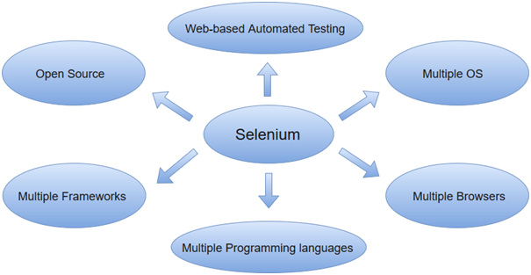
ABOUT SELENIUM
Selenium is one of the most widely used open source Web UI (User Interface) automation testing suite .It was originally developed by Jason Huggins in 2004 as an internal tool at Thought Works. Selenium supports automation across different browsers, platforms and programming languages.
Selenium can be easily deployed on platforms such as Windows, Linux, Solaris and Macintosh. Moreover, it supports OS (Operating System) for mobile applications like iOS, windows mobile and android.

Slide 3
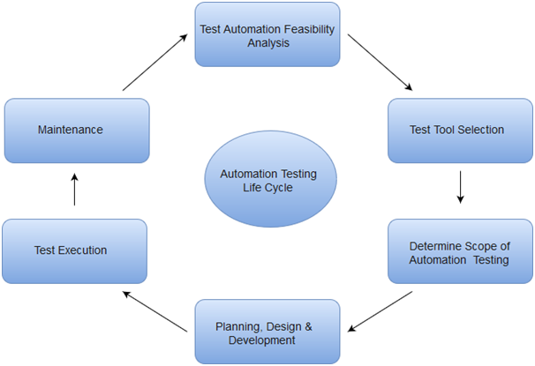
AUTOMATION TESTING:
Automation testing uses the specialized tools to automate the execution of manually designed test cases without any human intervention. Automation testing tools can access the test data, controls the execution of tests and compares the actual result against the expected result. Consequently, generating detailed test reports of the system under test.
Automation testing covers both functional and performance test on an application.
Functional automation is used for automation of functional test cases. For example, regression tests, which are repetitive in nature, are automated.
Performance automation is used for automation of non-functional performance test cases. For example, measuring the response time of the application under considerable (say 100 users) load.

Slide 4
SELENIUM FEATURES:
Selenium is an open source and portable Web testing Framework.
Selenium IDE provides a playback and record feature for authoring tests without the need to learn a test scripting language.
It can be considered as the leading cloud-based testing platform which helps testers to record their actions and export them as a reusable script with a simple-to-understand and easy-to-use interface.
Selenium supports various operating systems, browsers and programming languages. Following is the list:
Programming Languages: C#, Java, Python, PHP, Ruby, Perl, and JavaScript
Operating Systems: Android, iOS, Windows, Linux, Mac, Solaris.
Browsers: Google Chrome, Mozilla Firefox, Internet Explorer, Edge, Opera, Safari, etc.
It also supports parallel test execution which reduces time and increases the efficiency of tests.

Slide 5
SELENIUM LIMITATIONS
Selenium does not support automation testing for desktop applications.
Selenium requires high skill sets in order to automate tests more effectively.
Since Selenium is open source software, you have to rely on community forums to get your technical issues resolved.
We can't perform automation tests on web services like SOAP or REST using Selenium.
We should know at least one of the supported programming languages to create tests scripts in Selenium WebDriver.

Slide 6
SELENIUM TOOL SUITE
Selenium is not just a single tool but a suite of software, each with a different approach to support automation testing. It comprises of four major components which include:
Selenium Integrated Development Environment (IDE):
Selenium IDE is implemented as Firefox extension which provides record and playback functionality on test scripts. It allows testers to export recorded scripts in many languages like HTML, Java, Ruby, RSpec, Python, C#, JUnit and TestNG.
2.SELENIUM REMOTE CONTROL:
Selenium RC (officially deprecated by selenium)allows testers to write automated web application UI test in any of the supported programming language It also involves an HTTP proxy server which enables the browser to believe that the web application being tested comes from the domain provided by proxy server.
3.SELENIUM WEBDRIVER:
Selenium WebDriver (Selenium 2) is the successor to Selenium RC and is by far the most important component of Selenium Suite. Selenium WebDriver provides a programming interface to create and execute test cases. Test scripts are written in order to identify web elements on web pages and then desired actions are performed on those elements.
4.SELENIUM GRID:
Selenium Grid is also an important component of Selenium Suite which allows us to run our tests on different machines against different browsers in parallel. In simple words, we can run our tests simultaneously on different machines running different browsers and operating systems

Slide 7
SELENIUM IDE FEATURES
Menu Bar
Tool Bar
Address Bar
Test Case Pane
Test Script Editor Box
Start/Stop Recording Button
Log, Reference Pane

Slide 8
SELENIUM COMMANDS
1.ACTIONS:
Actions are the selenium commands that generally manipulate the state of the application. Execution of Actions generates events like click this link, select that option, type this box, etc. If an Action fails, or has a bug, the execution of current test is stopped.
2.ACCESSORS:
Accessors are the selenium commands that examine the state of the application and store the results in variables. They are also used to automatically generate Assertions.
3.ASSERTIONS:
Assertions are the commands that enable testers to verify the state of the application. Assertions are generally used in three modes assert, verify and wait for.

Slide 9
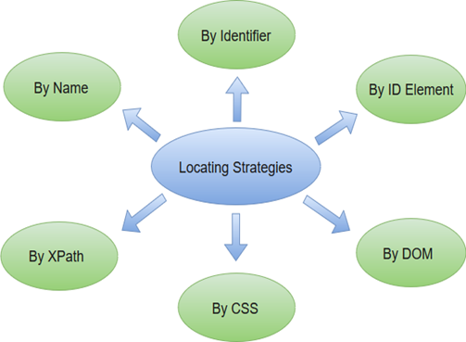
SELENIUM-IDE LOCATING STRATEGIES

Slide 10

THANK YOU...

